Slide 1
Capstone Team #5 2016-2017
VR Culture Simulation
Daniel Johnson
T. Avery Eich
Asad Ashur

Slide 2
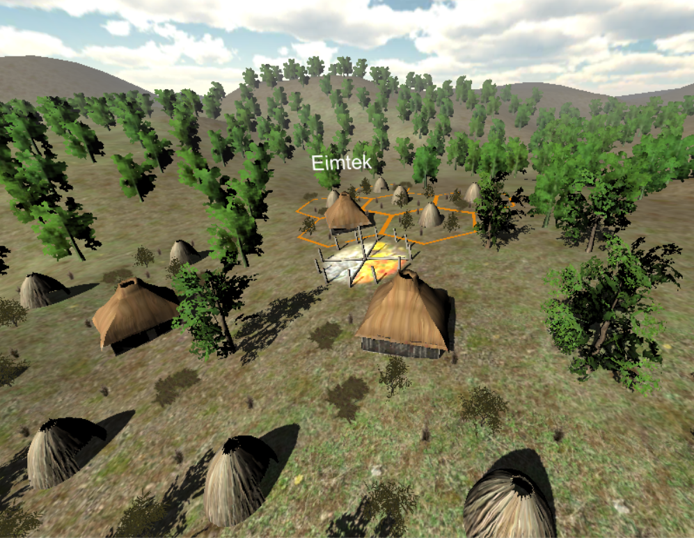
Genre Research
360-degree VR
Simulation
Dynamic
Procedural Generation

Slide 3
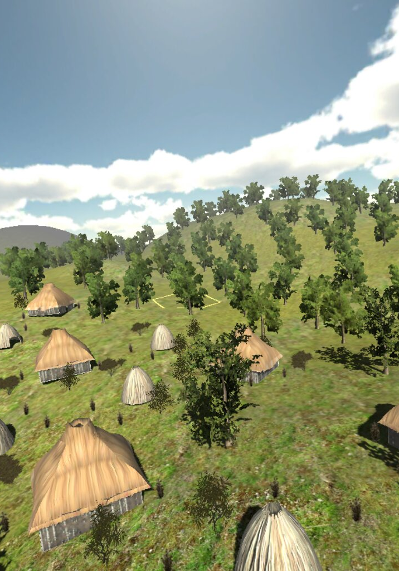
Civilization esq.
1. Overview, bird's eye view.
2. Interactions between houses occur on this level.
3. Game elements and the effects of seasons are visible.
4. Gather resources and manage community.

Slide 4
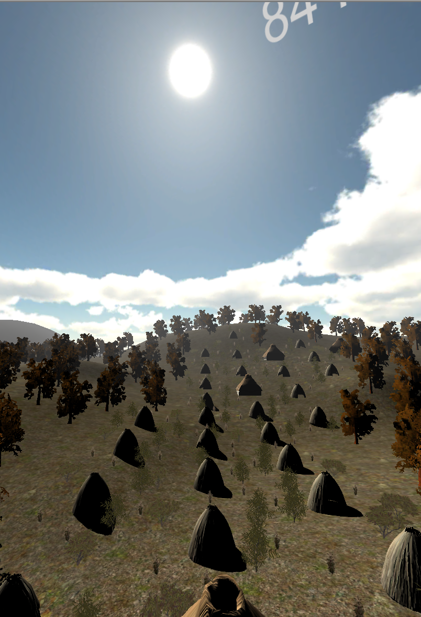
Oregon Trail Esq.
1. Survive rough elements by preparing and focusing on what you need to survive.
2. Instead of traveling, keep your family going through centuries of what we think might have been their living conditions, by providing items and tools your people need.
3. Gather Resources and produce Finished Goods
4. All assets gained through seasonal Activities.

Slide 5
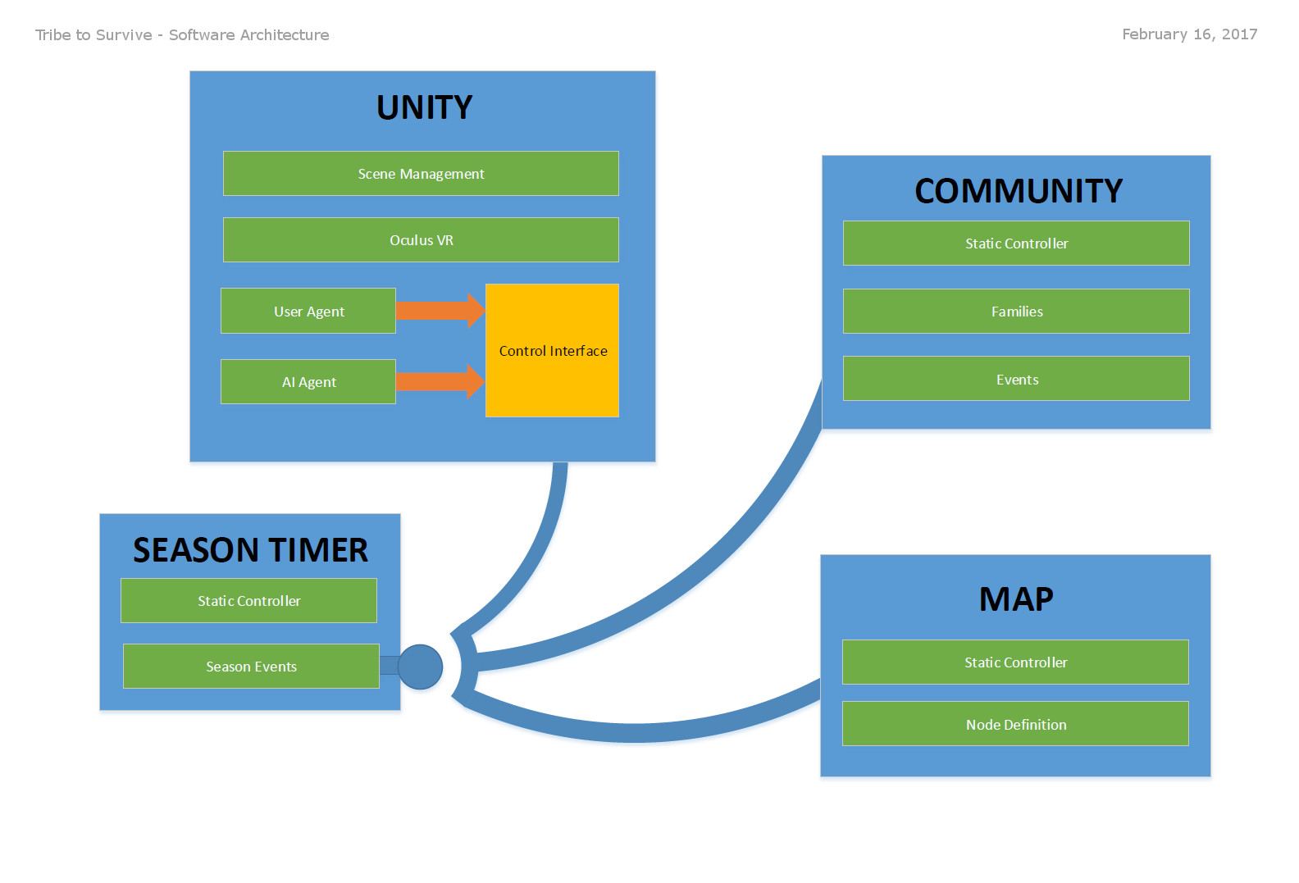
Application Architecture

Slide 6
Technical Design
1. Civilization
2. Oregon Trail
3. Language

Slide 7
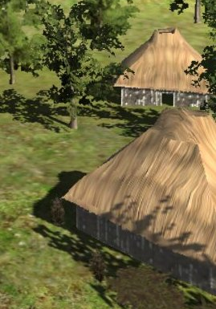
Family Attributes
Population of the whole family
Population growth per season = (Prosperity * Households) * 0.5
Households – Individual homes grow in number.
Skill – Each of Activities: Hunting, Gathering, Farming, Production
10 (base) skill gained when focused each season.
Capability = ((10% of each Skill) / 100) * Population. (Round Down)
Wealth = Sum of Value of all Raw Materials and Finished Goods
Prosperity = (Capability + Wealth) / Population
Needs = array of required amounts of finished goods
Unmet needs trigger events.
Fire Need = 0.30*Population
Clothing Need = 0.25*Population
Food Need = Population

Slide 8

Season Timer
Results of events and activities calculated at end of each season.
Activities (Hunting/Gathering, etc.) yield raw materials.

Slide 9
Activities and Assets
Activity | Bone | Clay | Fiber | Shells | Stone | Wood | Hide | Food
Hunting | b |  |  |  |  |  | c | d
Gathering |  | a |  | a | a | c |  | a
Farming |  | a | b | a | a |  |  | c
Raw Materials | Wealth Value
Bone | 6
Clay | 3
Fiber | 2
Shells | 8
Stone | 1
Wood | 3
Skins | 5
Food | 1
Activity Yield Modifiers:
a = 0.25, b = 0.4, c = 0.6, d = 1.0
One (1) food is deducted for each member of the Population each season.
Food shortage will cause “starvation,” where half the people who lack food die while the rest starve but somehow survive.

Slide 10
Assets - Finished Goods
Good | Material(s) | Bonus Yield (0.01)X | Finished Good Bonus (X) | Bonus******* | Time Cost
Homes | 20 Wood, 4 Skins | Production, Farming | +.75X |  | 1
Pottery | 5 Clay, 1 Shell, 1 Wood | Gathering, Farming | +.01X |  | 0.1
Tools * | 1 Stone, 2 Wood, 2 Fiber | Production, Hunting |  | Used by doing any activity | 0.2
Jewelry | 5 Shells, 1 Fiber |  |  | -- | 0.25
Clothes * | 3 Fiber, 5 Skins |  |  | Need 0.25*Population = Stock Each Season | 0.1
Fire* | 4 Wood |  |  | Need 0.5*Population = Expended per season | 0.1
Finished goods modify family performance.
Increase Material Yield
Decrease production time
Wealth Values
Increases Prosperity

Slide 11
Software Architecture

Slide 12
Application Architecture

Slide 13
Community Class
Community
Members:
List<Family> m_Families
Methods:
AddFamily( Family addNew )
SeasonEnded( SeasonTimer.SeasonEndEventArgs e )
…
Static control class.
Contains/maintains:
Families
Environmental/Global Events
Responds to SeasonTimer event(s).

Slide 14
Family Class
Family
Members:
int Population
List<RawMaterial> Materials
List<FinishedGood> FinishedGoods
List<MapNode> FamilyNodes
List<TribalEvent> FamilyEvents
Skill CurrentActivity
Methods:
FamilySeasonEnd( SeasonTimer.SeasonEndEventArgs e )
AddMaterials(RawMaterialType matTyp, int count = 1)
AddGood(FinishedGoodType goodTyp, short tier, int count = 1)
AddFamilyNode( MapNode n )
Contains/maintains:
Attributes of single family.
Materials and goods of family
Family-specific events.
Responds to SeasonTimer event(s).

Slide 15
Finished Good Class
Combines RawMaterials.
Has a “Tier,” or quality.
Contains Methods to manipulate/create goods.
FinishedGood
Members:
List<RawMaterial> Materials
FinishedGoodType Type
int Tier
int WealthValue
float TimeToProduce
Methods:
CanCreate(List<RawMaterial> mats, FinishedGoodType goodType, int tier)
Upgrade(List<RawMaterial> mats, FinishedGood subject)
CreateFromMaterials(List<RawMaterial> mats, FinishedGoodType goodType, int tier)
AddMaterial(RawMaterial mat)
…

Slide 16
Collection of methods and properties of a raw material.
Contains static methods to manipulate lists of RawMaterial classes.
RawMaterial
Members:
RawMaterialType Type
int WealthValue
Methods:
GetMaterials( List<RawMaterial> mats, RawMaterialType typ )
…

Slide 17
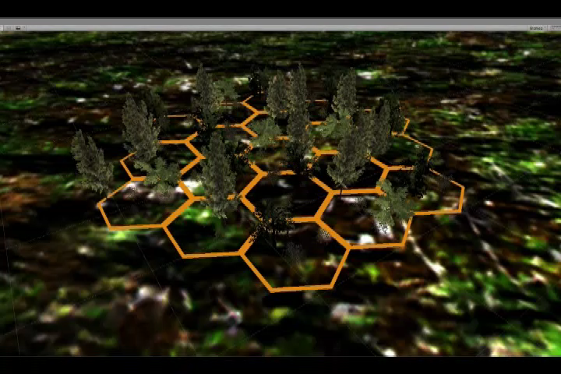
Map Generation

